Slide 2
Class 4
Languages, Interaction

Slide 3
Turn video on,
enable mic
Share a book you recently
read/listened to

Slide 4
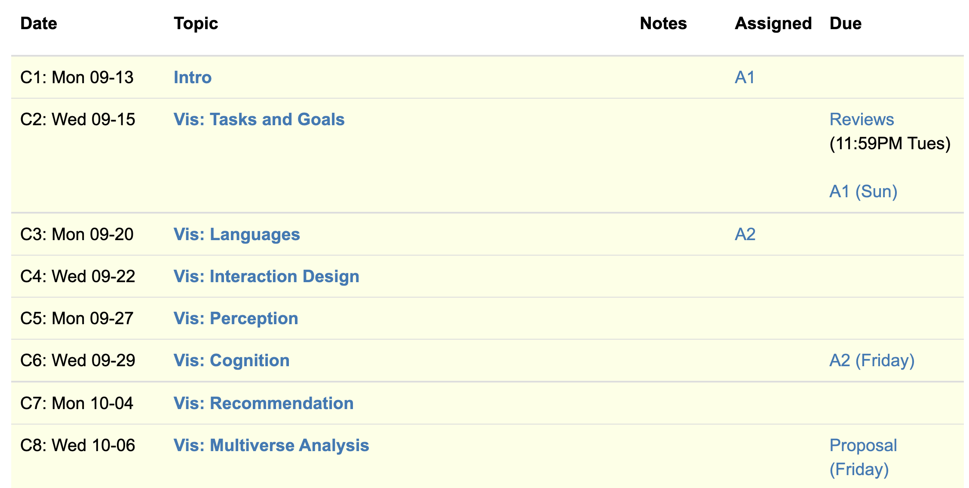
Logistics
A2 released.
Think about project proposal. 2 office hours left!

Slide 5
Each group assigns notetaker
G1: How does the instrumental interactions model apply to interactive visualizations?
G3, 4: Where do interface languages fit into the instrumental interactions model?
Notes:
How did you pick the other vis language?

Slide 6

Support your colleagues
for speaking up!

Slide 7
Each group assigns notetaker
G1, 2: How does the instrumental interactions model apply to interactive visualizations?
G3, 4: Where do interface languages fit into the instrumental interactions model?

Slide 8
Interactive Interfaces as Domain Specific Languages

Slide 10
Class 3
Languages

Slide 11
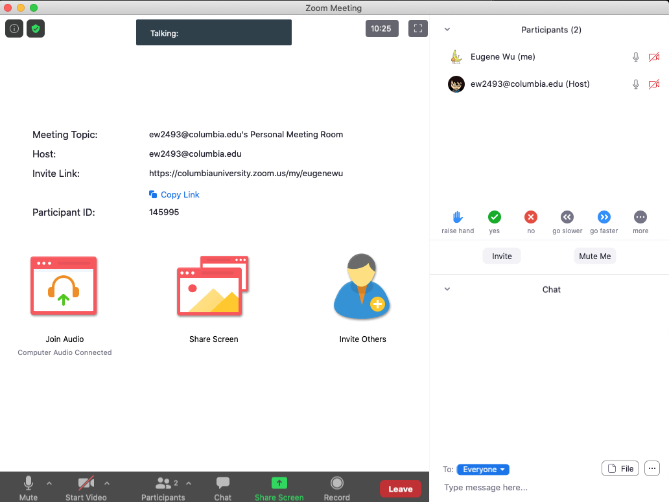

Turn video on,
enable mic & say:
“Hi, this is _(name)_,
I usually eat ________ for lunch”
Click when done
Participants
Chat

Slide 12
Logistics
A1 was due last night
A2 released.

Slide 13
Each group assigns notetaker
G1 and 2: What criteria makes a HDI language good? Put the criteria into action: pick a domain/task and make up a language.
G3 and 4: discuss the strengths and weaknesses of how the paper is communicated. Share the top strength and top weakness.
Notetaker shares what you came up with and the process.
Notes:
How did you pick the other vis language?

Slide 14
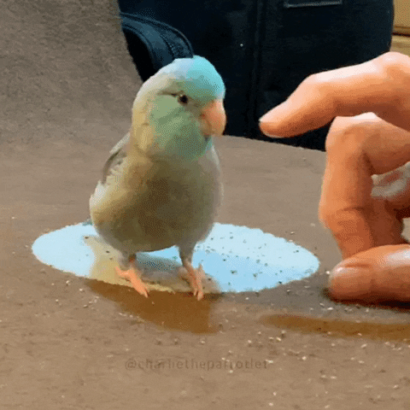
Support your colleagues
for speaking up
A quick thanks or follow up
is great

Slide 15
Each group assigns notetaker
G1 and 2: What criteria makes a HDI language good? Pick a domain/task and come up with a language.
G3 and 4: discuss the strengths and weaknesses of how the paper is communicated. Share the top strength and top weakness.
Notetaker shares what you came up with and the process.

Slide 16
Technique
Is it correct?
Does it make sense?
Is it as simple as possible?
Are decisions unnecessarily complex?

Slide 17
Comunication
What is the appropriate audience?
How well do they justify
Design decisions?
Technical approach?
The problem itself?

Slide 18
Experiments
What SHOULD have been done?
How should it be measured?

Slide 19
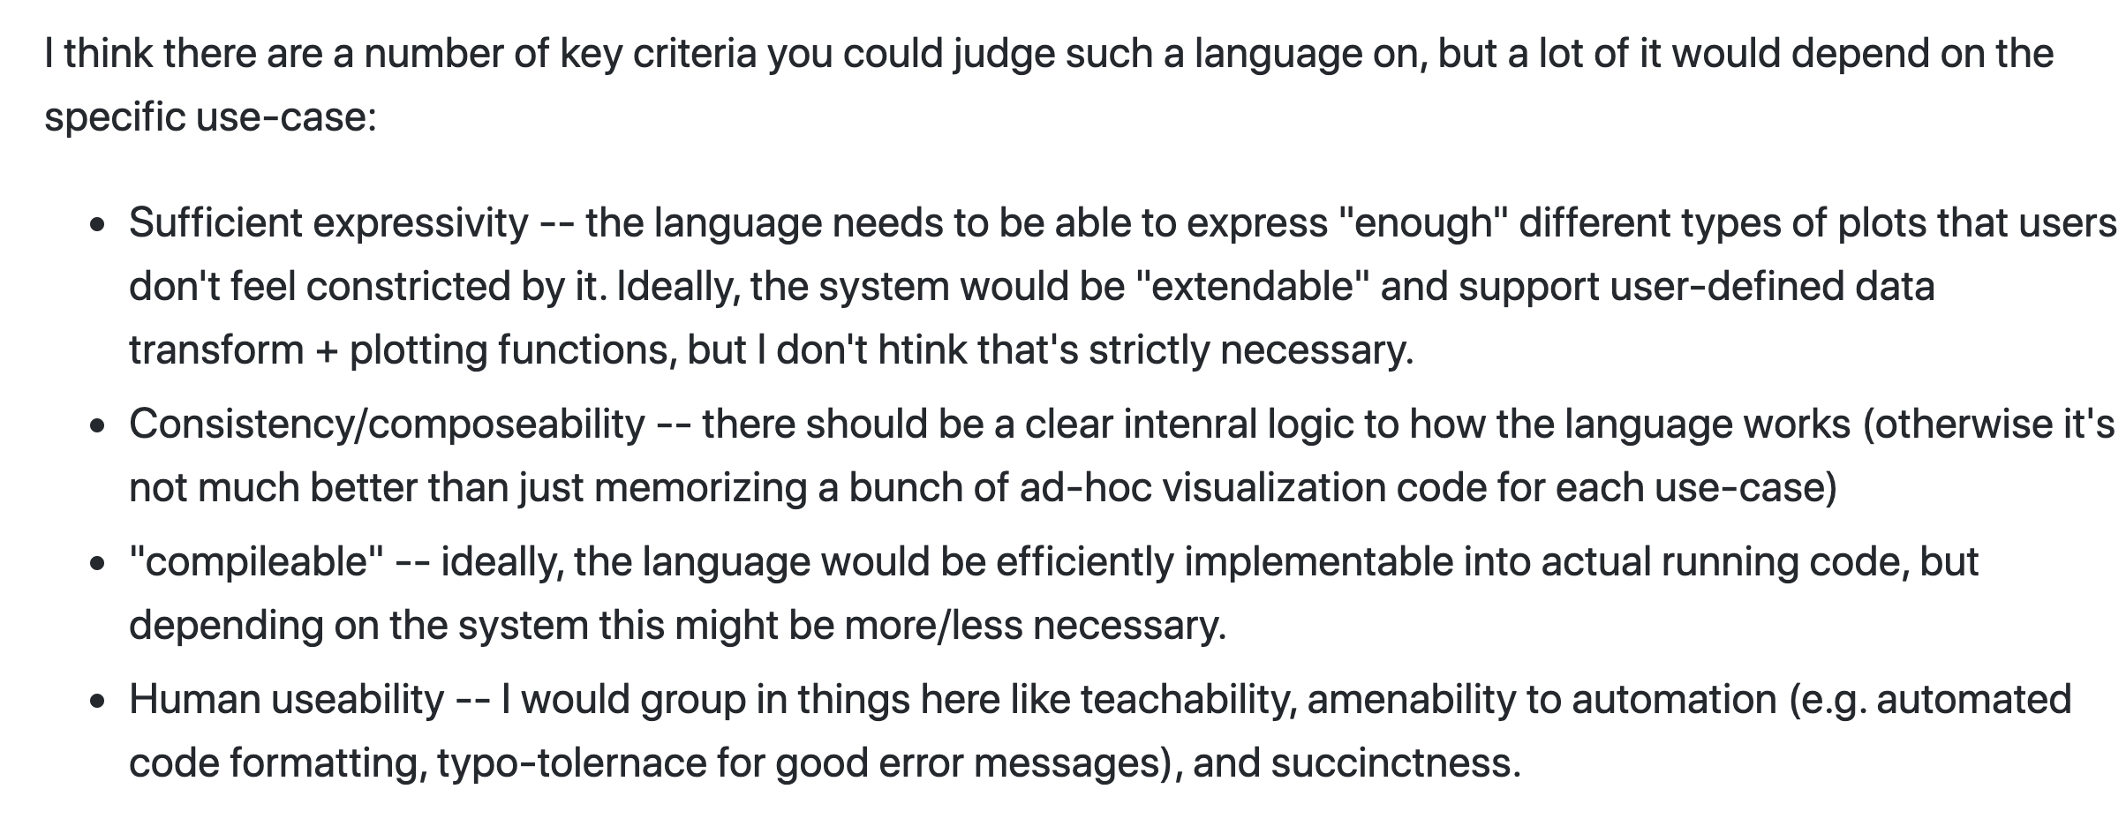

Slide 20
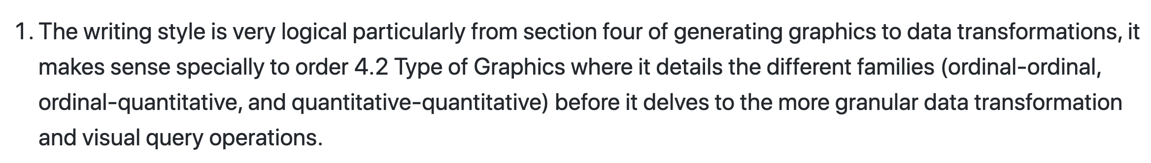

Slide 21
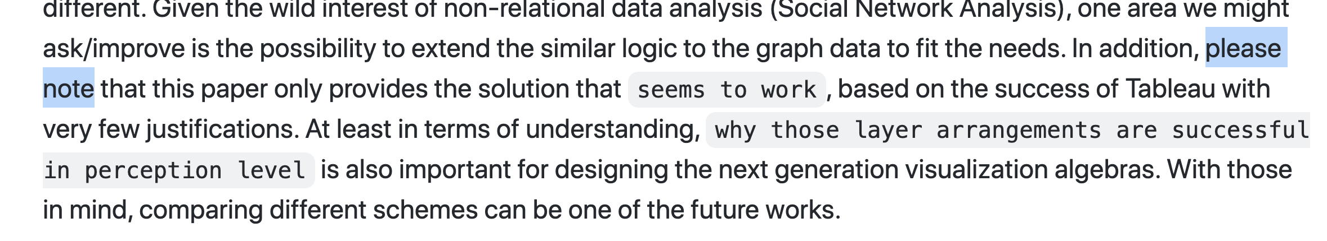

Slide 22
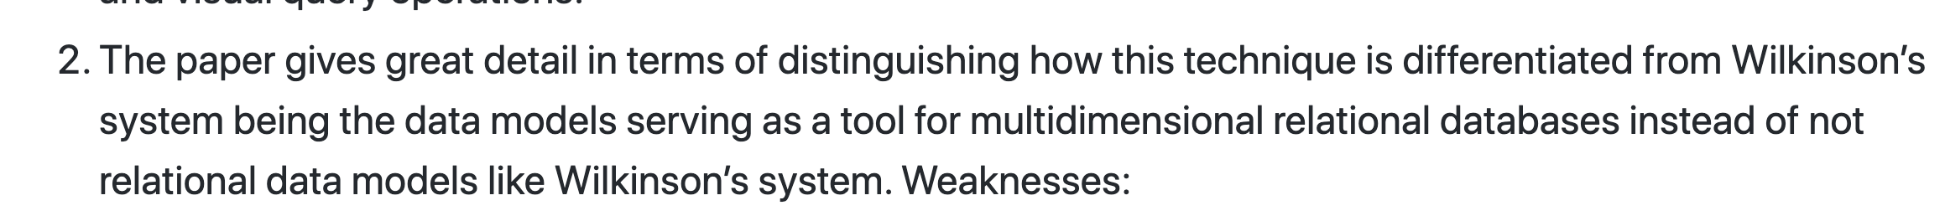

Slide 23
Class 2
Tasks

Slide 24
Discussion prompt:
Recent book that you find memorable

Slide 25


Slide 26
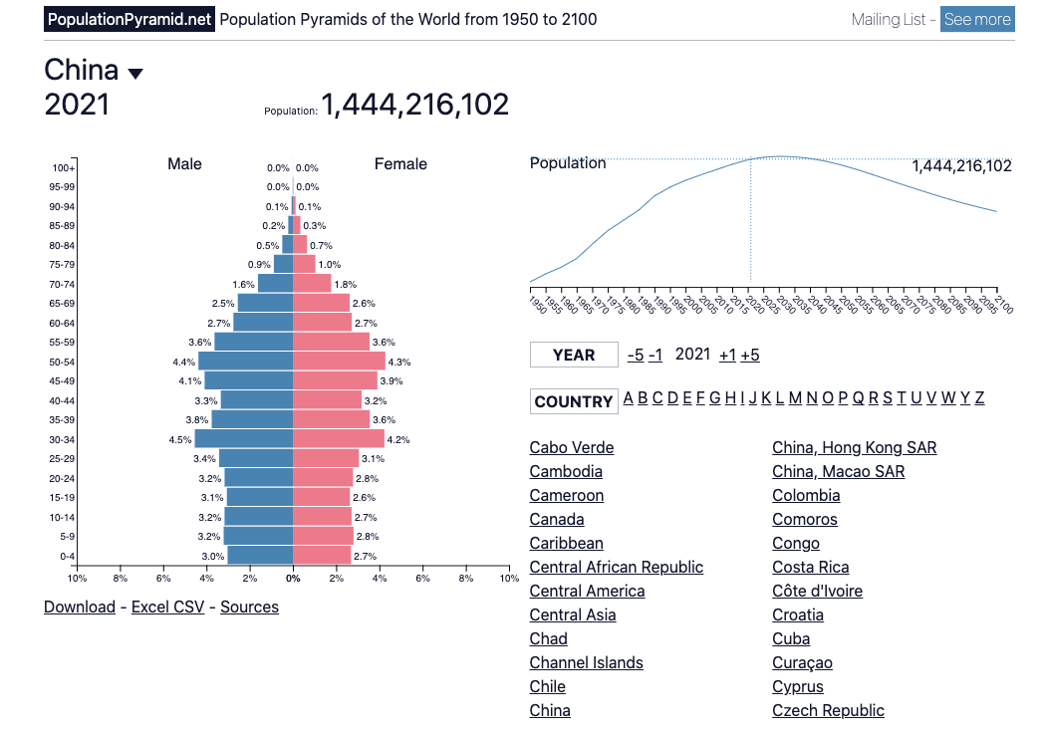

Slide 27
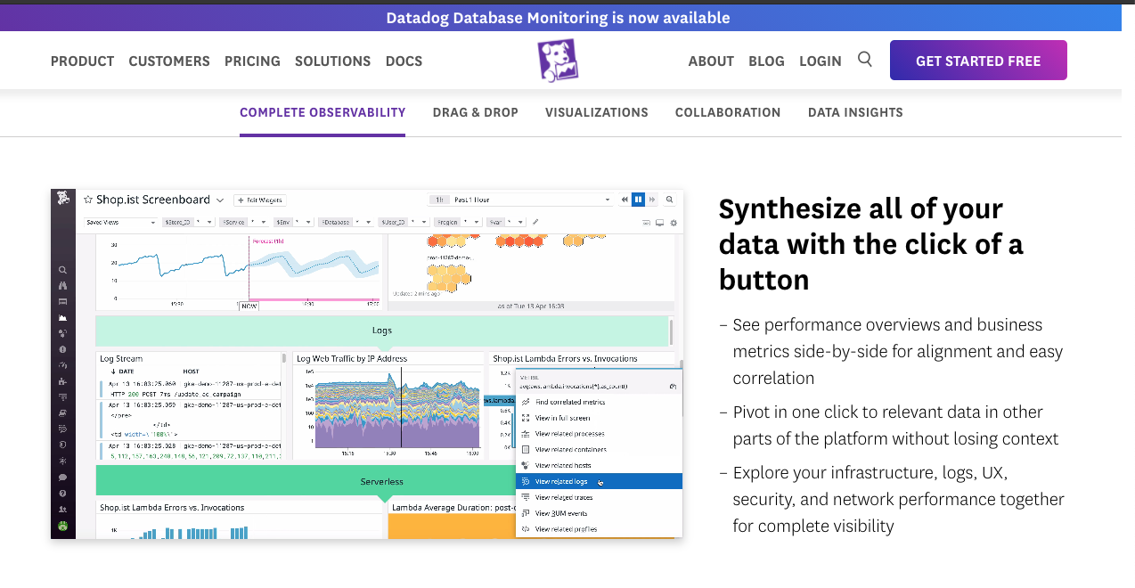

Slide 28
Each group assigns notetaker
Groups of 4:
You back-fitted task descriptions from a visualization. Discuss your process, what made it easy/difficult, and reflect on the applicability of the task typology.
Bonus, choose a visualization and task to share with the class. (connect to zoom, share screen)

Slide 29
Support your colleagues
for speaking up
A quick thanks or follow up
is great

Slide 30
Each group assigns notetaker
Groups of 4:
Discuss and share the visualization and task description you created in the review.
Choose one that notetaker will share with the class
(connect to zoom, share screen)

Slide 31
TODOs
A1!!

